Slide 1

RenewAgra Technical Solution Design Exemplar
THE FUTURE OF CROPS

Slide 2
Where are we?
Start
Fit-to-Standard Workshop Preparation
Technical Solution Design – Initial Approach
Customer Feedback Incorporation
Redesign and Finalization of Technical Solution Design
Q-Gate and Signoff
End

Slide 3
How does fit-to-standard work?
Leverage existing functionality as much as possible
Leverage predefined configuration content as much as possible
Utilize features available for multiple countries and commonly used SAP products

Slide 4
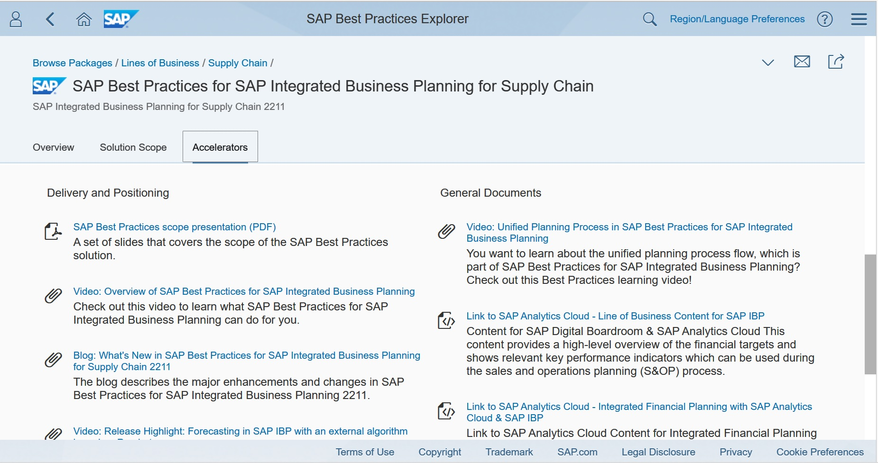
Example of a standard functionality
RenewAgra focuses on improving Supply Chain Management. Integrated Business Planning might be a functionality that we can consider.

Slide 5
Where are we?
Start
Fit-to-Standard Workshop Preparation
Technical Solution Design – Initial Approach
Customer Feedback Incorporation
Redesign and Finalization of Technical Solution Design
Q-Gate and Signoff
End

Slide 6
What will we do? CropCo
Farmer Agenda – Fiori mobile app for farmers, available on Android and iOS recent devices, machinery and truck schedules, irrigation and extreme weather alerts. Deployed on SAP BTP.
Crop Planner – Analytical tools for CropCo Operation Managers: machinery availability optimization (allocation, relocation, maintenance), leveraged by current EnvoData infrastructure.

Slide 7
What will we do? TransCorp
Fleet Calendar – Analytical tools for TransCorp Operation Managers: machinery availability optimization (allocation, relocation, maintenance), leveraged by current EnvoData infrastructure.
Shipments Planner – Analytical tools for TransCorp Operation Managers with real-time decision support capabilities for monitoring fleet operations and advise on rerouting options, leveraged by current EnvoData infrastructure.
Farmer Bookkeeper – Fiori mobile app for farmers – potential revenue, market trackers. Deployed on SAP BTP.

Slide 8
What will we do? EnvoData
Farming Planner – Analytical tools for EnvoData Data Analysts Managers – integration of Geographical Information Systems with imagery provided by drones and weather data provided by drones and other organizations. Advanced forecasting and simulation activities for crop yields and extreme weather alerts (short-term threats like floods warning or mid-term threats like drought) leveraged by current EnvoData infrastructure.

Slide 9
How ready are we?
EnvoData – Provides up-to-date S/4HANA systems. Those can be the foundation for leveraging best practices (example Maintenance) and reduce time/efforts.
EnvoData – Provides business intelligent tools, and most important HANA environments. Therefore, data modeling can be achieved there. We need to check about the availability of HANA XSA and if XSA modeling tools are deployed and the system is loaded with accurate GIS data.
EnvoData – For data provisioning. We need to validate existing infrastructure, deployment of addons on HANA. For example, the EIM (Enterprise Information Management) family for transforming data and AFL (Application Information Libraries) to enhance algorithms.
Network and B2B communications – Recommend SAP BTP but also validate current VPN possibilities for remote data load and access to mobile app content.

Slide 10
Where are we?
Start
Fit-to-Standard Workshop Preparation
Technical Solution Design – Initial Approach
Customer Feedback Incorporation
Redesign and Finalization of Technical Solution Design
Q-Gate and Signoff
End

Slide 11
Addressing customer feedback – 1/2
 | Customer Feedback | Resolution
1 | Mobile devices – Blackberry and potentially iOS and Android devices not fully compliant with Fiori needs. | Usage of workflows and notifications by emails can provide a fallback solution in case of non-compliant devices.
2 | Real-time data acquisition (fleet) – global GPS rollout to happen in 6 months. | Global GPS rollout to happen in 6 months. Shall we consider multiple functionality releases once the relevant devices are in place?
3 | Addons and complimentary software – Carbon footprint, not relevant now, other addons needed for data modeling/provisioning/transformation can be added to the existing landscapes. | Incorporate SAP EIM (SDI – provisioning, SDQ – transformation).

Slide 12
Addressing customer feedback – 2/2
 | Customer Feedback | Resolution
4 | Network and communications – Acceptance of SAP BTP as a simplifier for worldwide communication processes (B2C – business two consumer and B2B – business to business). For B2B the focus will still be point-to-point VPN across companies. SAP BTP will be the foundation for mobile apps | SAP BTP adoption – Incorporate SAP Cloud Connector to link cloud-based apps to on-premise systems, introduce SAP Cloud Identity Services to address Authentication, Authorization, Provisioning for cloud-based apps.
5 | As data will be moved into different jurisdictions, how can we address compliance needs? | Review SAP ILM functionality within S/4HANA, query customer for more advanced/complex needs.

Slide 13
Where are we?
Start
Fit-to-Standard Workshop Preparation
Technical Solution Design – Initial Approach
Customer Feedback Incorporation
Redesign and Finalization of Technical Solution Design
Q-Gate and Signoff
End

Slide 14
What will we do? CropCo
Farmer Agenda – Fiori mobile app for Farmers, available on Android and iOS recent devices, machinery and truck schedules, irrigation and extreme weather alerts. Deployed on SAP BTP.
Crop Planner – Analytical tools for CropCo Operation Managers: machinery availability optimization (allocation, relocation, maintenance), leveraged by current EnvoData infrastructure. Additional functionality for Maintenance and Logistics to be configured in SAP S/4HANA, new data models will be built using SAP HANA capabilities.
SAP BTP will provide Identity Services for CropCo (authentication, authorization, provisioning) for farmer end-users.

Slide 15
What will we do? TransCorp
Fleet Calendar – Analytical tools for TransCorp Operation Managers: machinery availability optimization (allocation, relocation, maintenance), leveraged by current EnvoData infrastructure.
Shipments Planner – Analytical tools for TransCorp Operation Managers with real-time decision support capabilities monitoring fleet operations and advise on rerouting options, leveraged by current EnvoData infrastructure. Additional functionality for Maintenance and Logistics to be configured in SAP S/4HANA, new data models will be built using SAP HANA capabilities
Farmer Bookkeeper - Fiori mobile app, for Farmers, potential revenue, market trackers. Deployed on SAP BTP. SAP BTP will provide Identity Services for CropCo (authentication, authorization, provisioning) for farmer end-users.

Slide 16
What will we do? EnvoData
Farming Planner – Analytical tools for EnvoData Data Analysts Managers: integration of Geographical Information Systems with imagery provided by drones and weather data provided by drones and other organizations. Advanced forecasting and simulation activities for crop yields and extreme weather alerts (short term threats like floods warning or mid term threats like drought) leveraged by current EnvoData infrastructure. The existing landscape will be enhanced with the deployment of SAP HANA XSA/WebIDe and additional functions such as AFL, SAP EIM and SAP HSA for providing better data provisioning, transformation and analysis capabilities.

Slide 17
RenewAgra – How ready are we?
To-Do before Realize: Ensure that existing landscape incorporates all needed addons and complimentary software.
To-Do before Realize: Estimate efforts, sequence of activities to perform in Realize, and ensure staff allocation, facilities availability.
To-Do: Build the final to-do list and the final validation list for Q-Gate, prepare signoff for next phase: Realize

Slide 18
Where are we?
Start
Fit-to-Standard Workshop Preparation
Technical Solution Design – Initial Approach
Customer Feedback Incorporation
Redesign and Finalization of Technical Solution Design
Q-Gate and Signoff
End

Slide 19
RenewAgra – Product Backlog
Mobile apps – Build app, write test scripts, create end-user materials, create configuration documentation, create development documentation for:
Farmer Agenda, Farmer Bookkeeper
Analytical tools – Build functionality, write test scripts, create end-user materials, create configuration documentation, create development documentation for:
Crop Planner, Farming Planner, Fleet Calendar, Shipments Planner
Processes – Build functionality, write test scripts, create end-user materials, create configuration documentation, create development documentation for:
Maintenance

Slide 20
RenewAgra – Q-Gate Checklist
Explore deliverables:
Are they signed-off?
Resources and staffing:
Are they identified?
Are they available when needed?
Realize project plan:
For Agile: Are the next activities, for the next 1-2 months (1-2 sprints), at least already determined? For Waterfall: Is the project plan finished?

Slide 21
RenewAgra – Lessons Learned
What went wrong?
We didn’t ask enough questions regarding data science/provisioning/transformation/modeling capabilities
What went well?
The scope suffered only minor changes, what the customer needed was identified almost accurately, only minor changes needed regarding the overall initial scope understanding (e.g., carbon footprint)

Slide 22
Where are we?
Start
Fit-to-Standard Workshop Preparation
Technical Solution Design – Initial Approach
Customer Feedback Incorporation
Redesign and Finalization of Technical Solution Design
Q-Gate and Signoff
End

